Slide 1
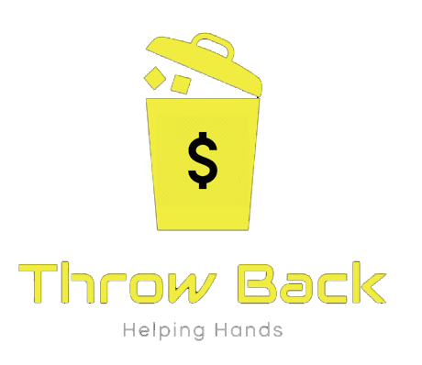
Throw Back -Smart dustbins
Team Details:
Akash P
T H Lakshana
Madhu Prakash
Preethi N

Slide 2
WHAT'S THE PROBLEM
Absence of appropriate number of dustbins.
Presence of other family members, peer pressure and even strangers who might influence our thought process.
Physiological barriers like Laziness , Ego, Attitude etc.
No strict policies from the government

Slide 3
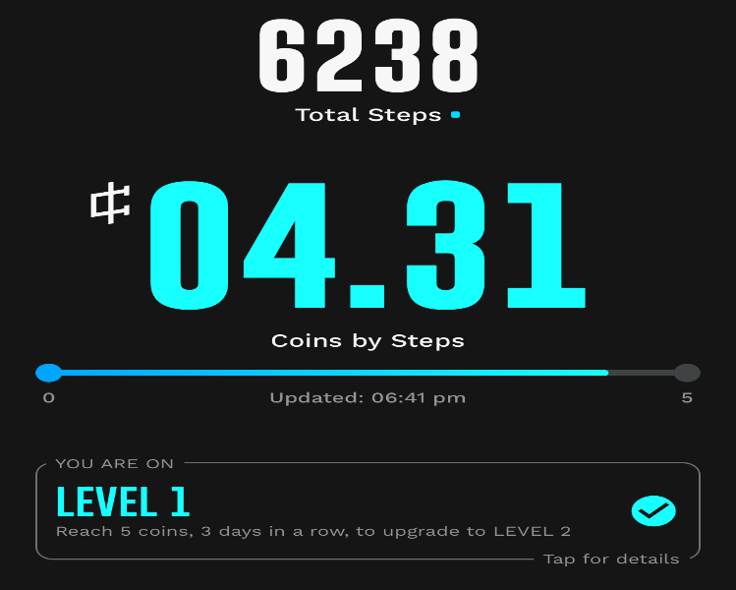
Idea
Solution
By using the barcode reader built in the dustbin, we can scan various types of consumer litter.
Using step set go model, one can get a set amount of reward points based on the commodity.

Slide 4
Our Security Measures
Restricting to unrooted devices
Installing ThrowBack dustbins near any shop
Keeping 5 seconds time restriction after scanning the product
Use of IR sensors to detect the waste type

Slide 5
MARKET
1
India ranks 123 in most cleanest countries.
2
Bangalore ranks 7th in India's most cleanest cities even though it is considered the technology hub of India.
3
Bangalore has a population of 10.8 miion and generates a average of 3500 tonnes of waste per day

Slide 6
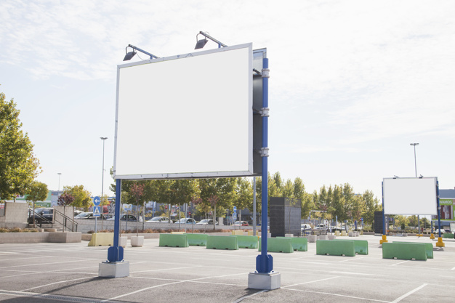
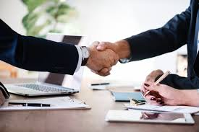
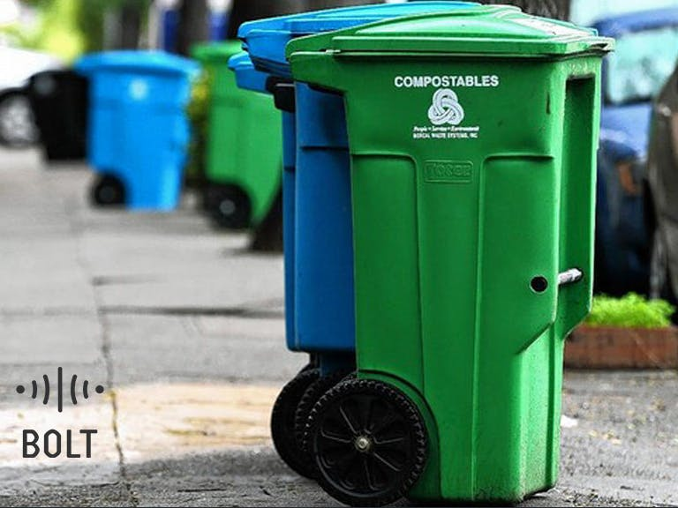

MARKETING AND SALES
HOARDINGS
PARTNERING
INSTALLING NEAR CROWED AREA

Slide 7
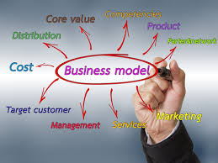
Business Model
PART ONE
Only specific brands will be eligible (like kurkure, lays etc.) to get the refund benefit
PART TWO
We can advertise brands on our app and also on our dustbins to earn a little more.
PART THREE
We can ask NGO’s and government for sponsorship
PART FOUR
In App Purchases to promote our game like feature of leveling up to earn more data PART FIVE
We can make money by selling our waste. We can partner with mobile operators to give more benefits to the consumer and the company.
PART SIX
In the later stages , the offline retailers will also sponsor us for installing data dustbins

Slide 8
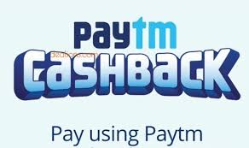

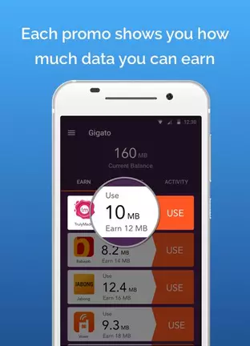
Competitors

Slide 9
Use of Funds
1)Initial investment in creating links with brands, with canteen etc
2)Preparing hoardings and posters on the street and for buying dustbins .
3)To set-up dustbins at public places and for maintenance.

Slide 10
Roadmap & Traction
DAY 20
DAY 45
Expansion into areas near the college and setting up of data-dustbins
45
20
Maintaining the flow of data by ensuring no security flaws, getting into a stable market with many partner brands etc.
1
DAY 1
??
App is introduced and college canteen products are initially only eligible for refund
Every citizen accepts the app and the streets are clean . Now when any person sees litter he picks it up with a smile on his face.

Slide 11
THANK YOU FOR YOUR TIME

